Slide 1



Case Study:
SimplyFly -
Air Ticket Booking System
By Srimathi R

Slide 2




SimplyFly – Air Ticket Booking System
Objective:
A secure backend system for booking and managing flights, built using Java and Spring Boot. It supports three roles: Admin, Flight Owner, and User, all authenticated with JWT.
Core Features:
User: Register, login, search flights, book tickets, view/update profile
Flight Owner: Add/manage flights they own
Admin: Full control – manage users, routes, flights, and bookings
JWT Authentication: Role-based secure access
Swagger UI: Interactive API testing
03
01
02

Slide 3
Tech Stack
Java 17
Spring Boot
Spring Security
JWT (stateless auth)
MySQL
JPA (Hibernate)
Swagger (OpenAPI 3) for documentation
03
01
02

Slide 4
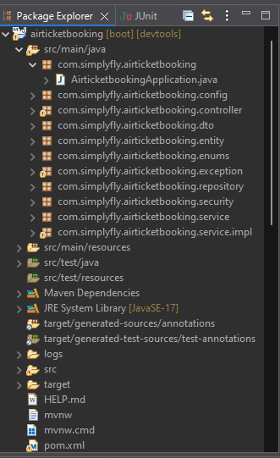
Project Structure
controller – API endpoints
dto – Request & response data structures
entity – Database models (User, Flight, Booking, etc.)
service – service interface
service implementation - Business logic
repository – Data access (JPA)
security – JWT utilities & filters
config – App & Swagger configuration
exception - custom exceptions and global exception handler
03
01
02

Slide 5
Role: ADMIN
User Management:
GET /api/users -> View all users
GET /api/users/{id} -> View specific user
DELETE /api/users/{id} -> Delete user
Flight Management
POST/api/flights → Add new flight
PUT /api/flights/{id} → Update any flight
DELETE /api/flights/{id} → Delete any flight
GET /api/flights → View all flights
GET /api/flights/{id} → View flight details
POST /api/flights/search → Search flights
Booking Management
GET /api/bookings/all → View all bookings
DELETE /api/bookings/{id} → Cancel any booking
03
01
02

Slide 6
Role: USER
Authentication
POST /api/auth/register → Register
POST /api/auth/login → Login
Profile
GET /api/users/me → View own profile
PUT /api/users/me → Update own profile
Flight Viewing
GET /api/flights → View available flights
GET /api/flights/{id} → View flight detail
POST /api/flights/search → Search by route and date
Booking
POST /api/bookings → Book a flight
GET /api/bookings/my → View own bookings
Seat
GET /api/seats/flight/{flightId} → View available seats on a flight
03
01
02

Slide 7
Role: FLIGHT OWNER
Flight Management
POST/api/flights → Add new flight
PUT /api/flights/{id} → Update any flight
DELETE /api/flights/{id} → Delete any flight
GET /api/flights → View all flights
GET /api/flights/{id} → View flight details
Seat
GET /api/seats/flight/{flightId} → View seat map for owned flights
03
01
02

Slide 8
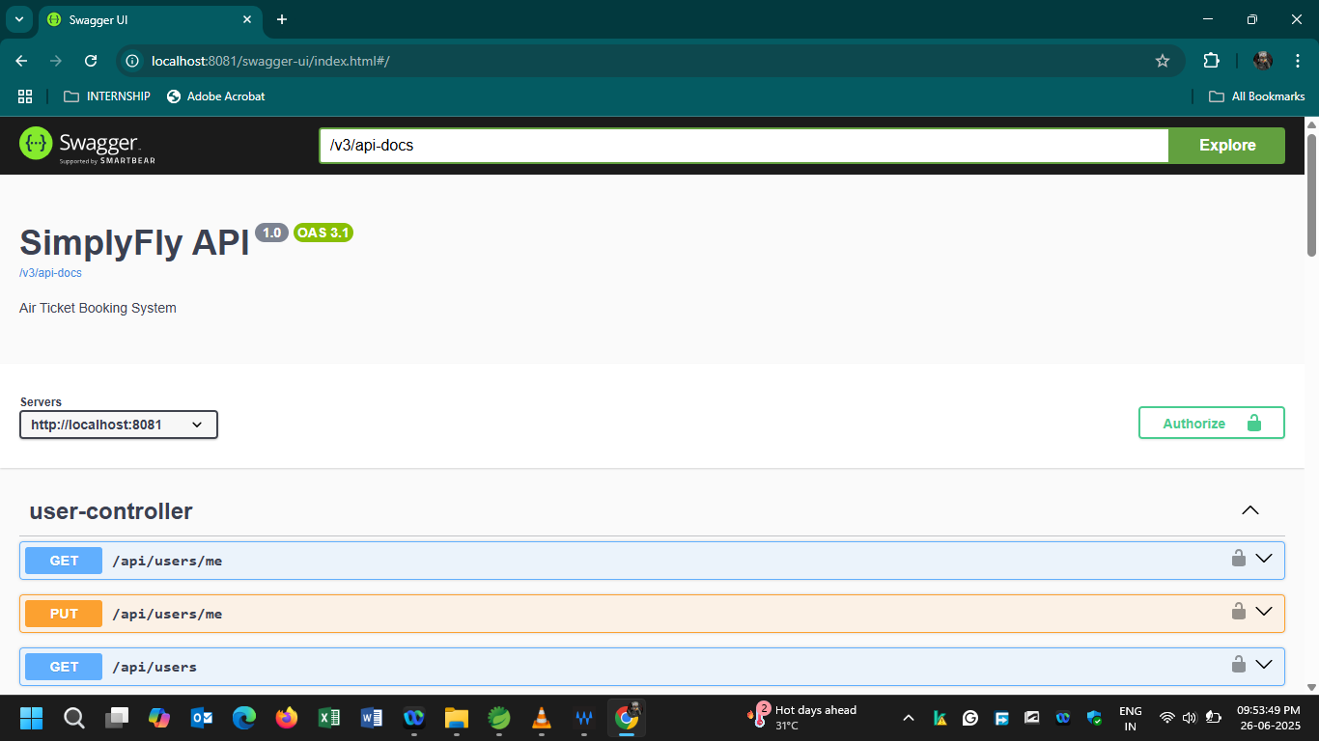
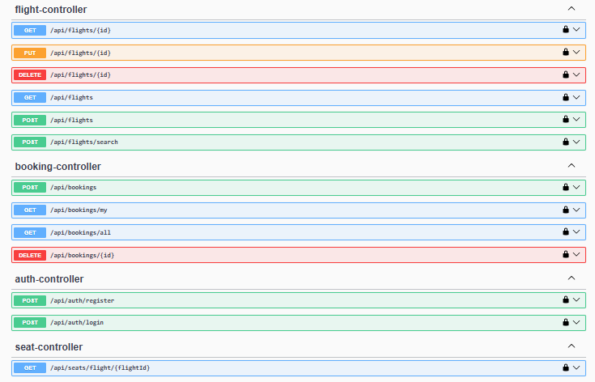
Output
03
01
02

Slide 9
03
01
WORK FLOW
(Based on Role of the User)
02

Slide 10
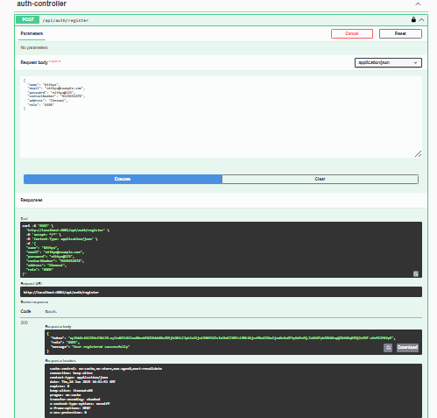
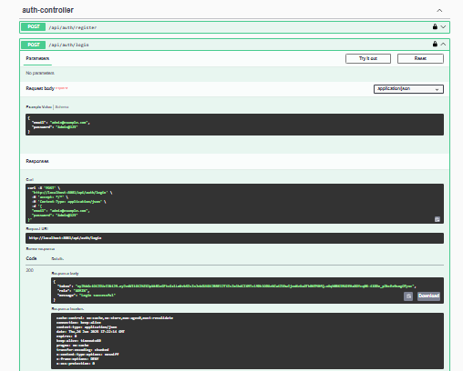
User Registration
User Login
03
01
02

Slide 11
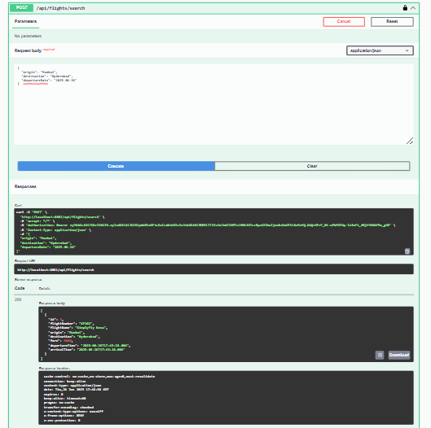
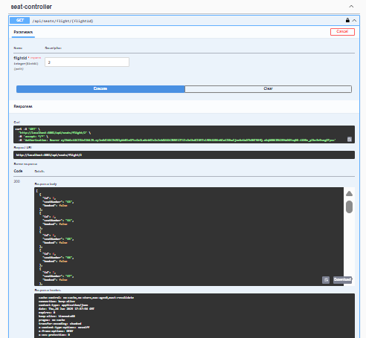
User: Searches Flights
User: Checks Seat Availability
03
01
02

Slide 12
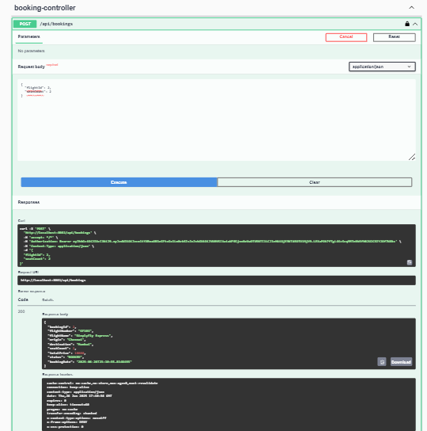
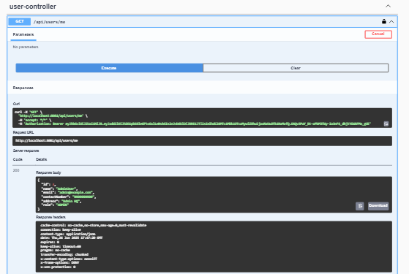
User: Books Flight Tickets
User: Checking their profile
03
01
02

Slide 13
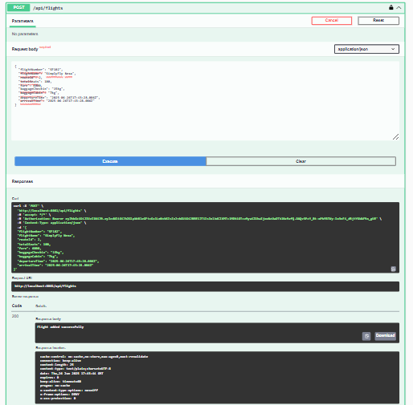
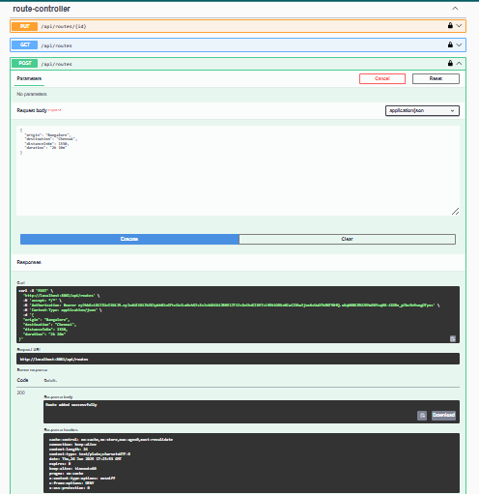
Admin: Adding new flight
Admin: Adding Route
03
01
02

Slide 14
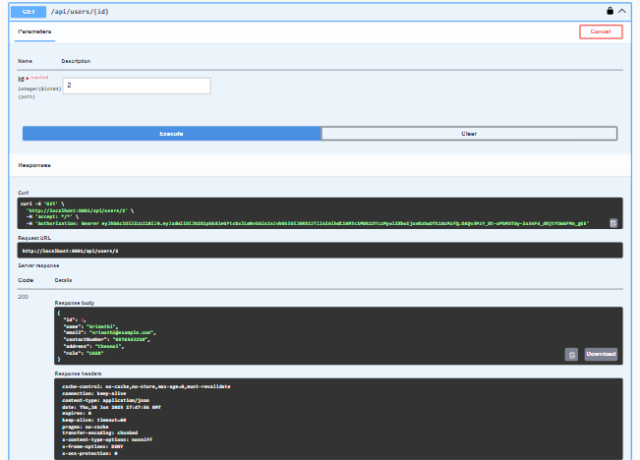
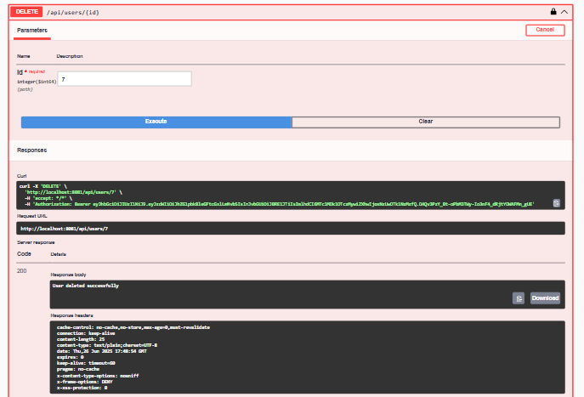
Admin: Getting user by their ID
Admin: Deletes user
03
01
02

Slide 15
Flight Owner : Getting user by their ID
Flight Owner: Deletes user
03
01
02

Slide 16
Flight Owner: Adding new flight
Flight Owner: Adding Route
03
01
02

Slide 17
CODING
03
01
Github Link: https://github.com/Srimathi-27/SimplyFly
02

Slide 18


THANK YOU

